Slide 1
CSE 464 : Software Quality Assurance and Testing
Testing Web Application / Distributed Software - I
Janaka Balasooriya

Slide 2
Testing Distributed /Web Applications
In this series of lectures we will try to understand
What is a distributed software?
Different types of web applications
  Client-Server
  Service Oriented
  Cloud Applications
Web application vs. Traditional Software
Testing web applications : A Bigger Picture
Test Automation
  Selenium as a Test Automation Tool for Web
Gray box testing
  Gray box testing in Web Applications
Software Architectures for Web Applications
Challenges in Web application testing

Slide 3
Distributed Computing Introduction
Distributed Information Systems
Any information system has requesters and service providers.
In general, information systems are designed around three layers: presentation layer, application layer, resource management layer.
The way these layers are arranged between service provider and the service requester determine if it is 1-tier, 2-tier,3-tier or n-tier.
Client
presentation layer
Information system
application logic layer
resource management layer
service provider

Slide 4
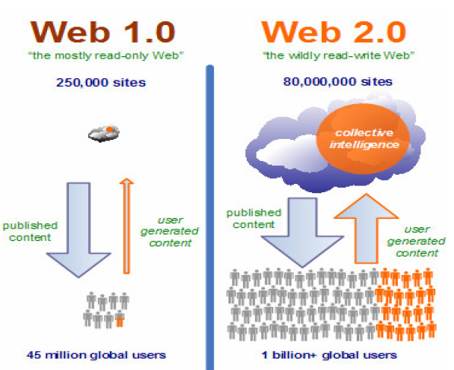
Evolution of Web
http://www.gsmodi.com/files/SOA_Web2_Report.pdf
Web 2.0 => web of applications

Slide 5
Web Application Categories
Client server architecture
SOA architecture
Cloud computing

Slide 6
Client Server Applications

Slide 7
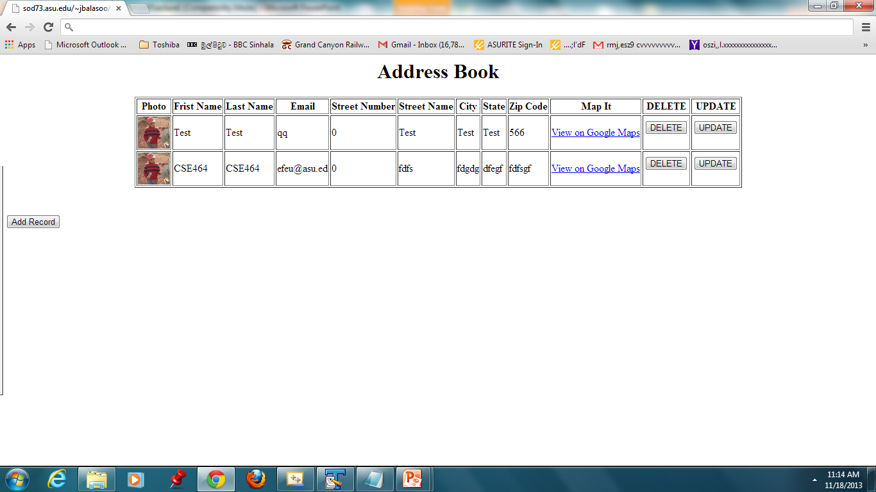

Slide 8
A Typical 3-tier Web Application
Server Scripts – Receives/responds to user calls
Client
Data Management Modules

Slide 9
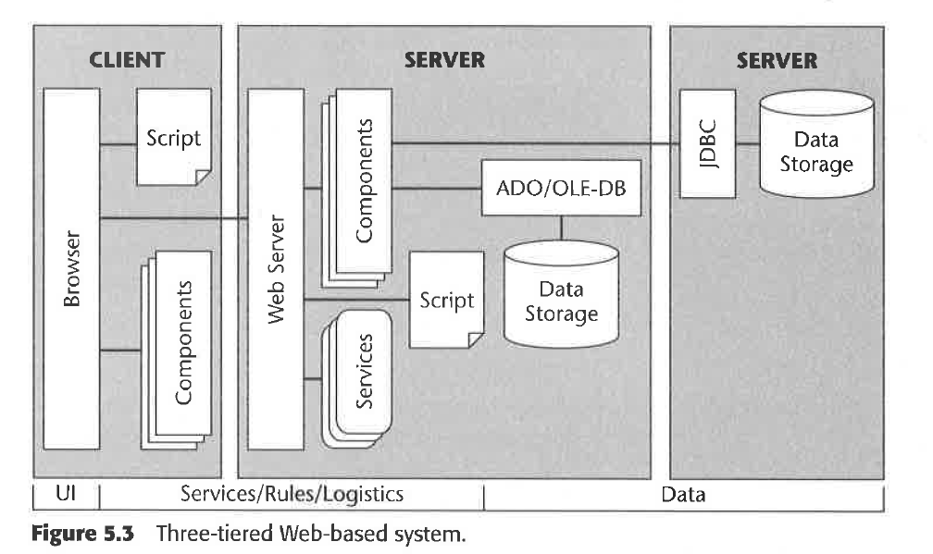
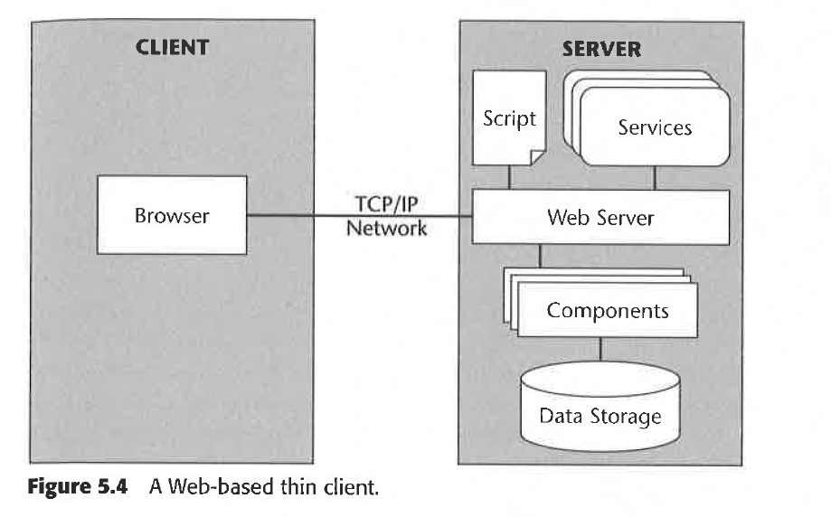
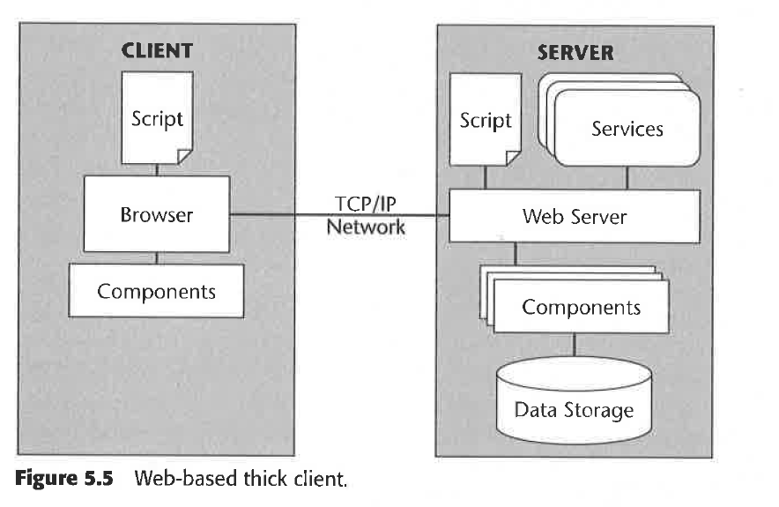
Reference: Testing applications on the Web, Hang Nguyen, Bob Johnson, Michael Hackett

Slide 10
Issues in Testing a Typical Web Software
Web applications are loosely coupled and components are distributed
Data pertaining to one application is scattered among different devices
Heterogeneity of devices, configurations and software systems
Dynamic adaptation to local settings

Slide 11
Testing Web Applications : A Bigger Picture

Slide 12
Gray-Box Testing Approach
Gray-Box testing incorporates elements of both black-box and glass-box (white-box) testing
Gray-Box testing considers
  Testing outcome on the end user
  System specific technical knowledge
  Operating environment
  Application design in the context of interoperability of system components
Gray-box testing is the most appropriate testing technique for web application testing

